Slide 1
SDR on Hack RF One

Slide 2
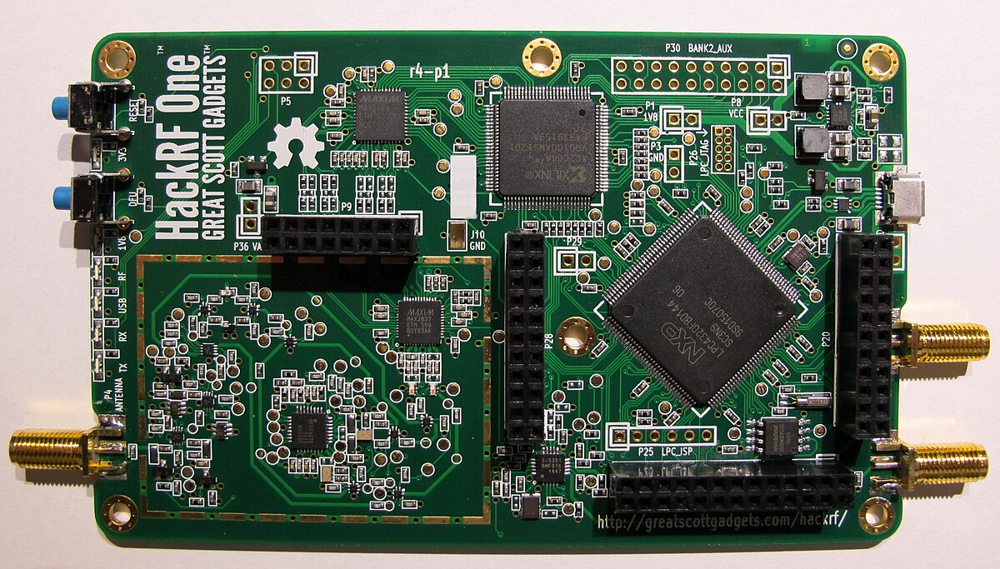
HACKRF One
HackRF One from Great Scott Gadgets is a Software Defined Radio peripheral capable of transmission or reception of radio signals from 1 MHz to 6 GHz. Designed to enable test and development of modern and next generation radio technologies.

Slide 3
HACKRF One Features
HackRF One is an open source hardware platform that can be used as a USB peripheral or programmed for stand-alone operation.
1 MHz to 6 GHz operating frequency
half-duplex transceiver
up to 20 million samples per second (ADC Clk)
8-bit quadrature samples (8-bit I and 8-bit Q)
compatible with GNU Radio, SDR#, and more
software-configurable RX and TX gain and baseband filter
software-controlled antenna port power (50 mA at 3.3 V)
SMA female antenna connector
SMA female clock input and output for synchronization
convenient buttons for programming
internal pin headers for expansion
Hi-Speed USB 2.0
USB-powered
open source hardware

Slide 4
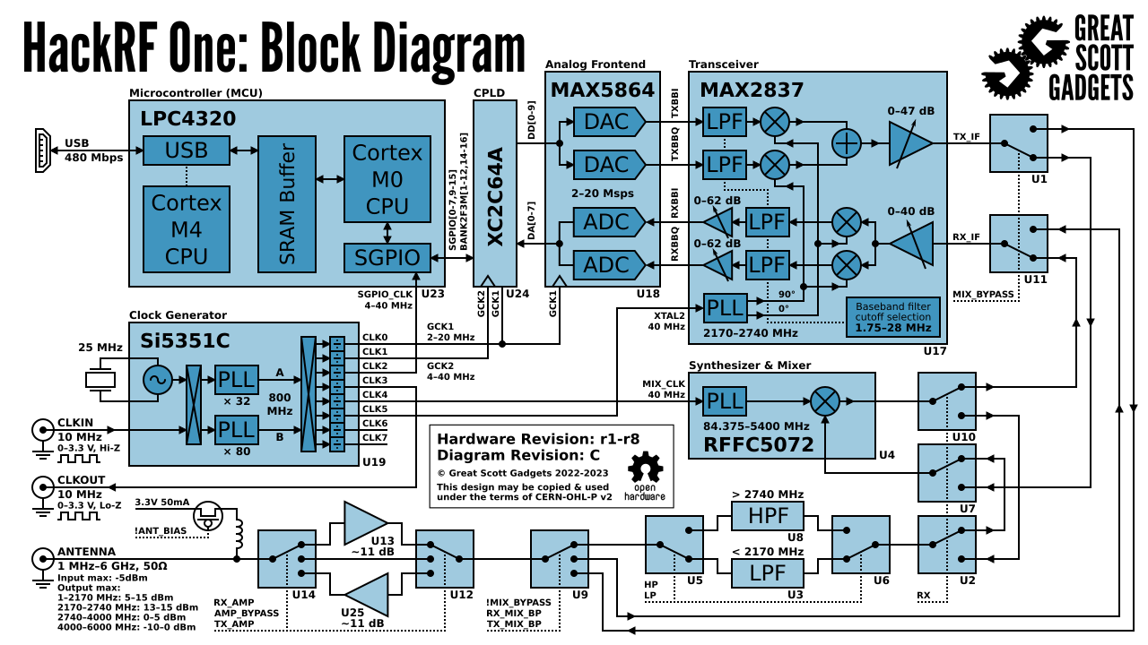
HACKRF One Architecture

Slide 5
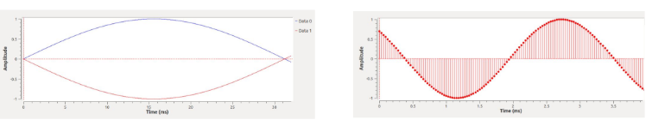
Time Domain
Amplitude values over time
Signals are continuous in the air or wire
Signals are digitized by sampling the current value many times

Slide 6
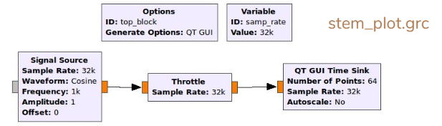
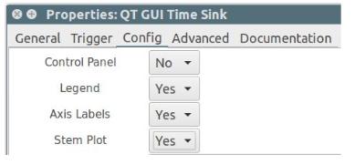
Discrete Sampling
Usually data is displayed as if it were continuous
Easier to visualize
Mostly accurate as long as you follow Nyquist’s Sampling Law
Can also display actual data points
Select Stem Plot under the Config menu in QT GUI Time Sink

Slide 7
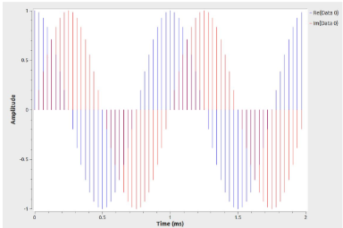
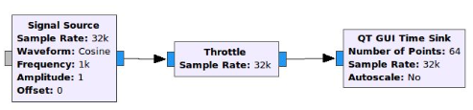
Complex Sampling
Hard to make fast ADC/DACs When mixing a signal with a sinewave crossing zero you lose all the information!
Solution: Split the signal in two, mix with a sine and cosine, sample each result at the same time
Twice the information, all of it useful
Not cheating Nyquist
Bandwidth = Sample Rate

Slide 8
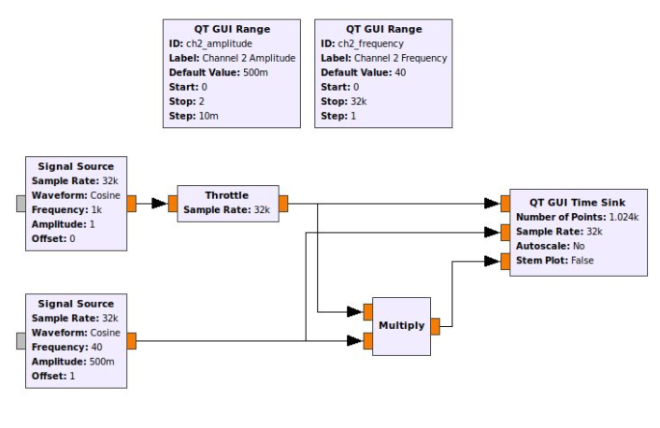
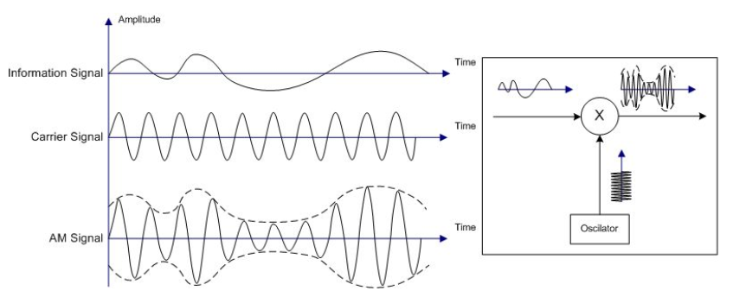
Amplitude Modulation
Changing the amplitude of a “carrier” wave at a fixed frequency.

Slide 9
Modulation Techniques HACKRF One is capable of
Some of them are as follows:
AM (Amplitude Modulation)
ASK (Amplitude Shift Keying)
FSK (Frequency Shift Keying)
BPSK (Binary Phase Shift Keying)
QPSK (Quadrature Phase Shift Keying)
OQPSK (Offset Quadrature Phase Shift Keying)
NBFM (Narrowband Frequency Modulation)
WBFM (Wideband Frequency Modulation)
SSB LSB (Single Sideband Lower Sideband)
SSB USB (Single Sideband Upper Sideband)

Slide 10
Modulation demos
https://github.com/raam96/HackrfONE_RTLSDR_demo

Slide 11
ASK Modulation and Demodulation
https://www.researchgate.net/figure/GRC-flow-graph-for-ASK-modulation-and-demodulation_fig16_338436204
Transmittion and reception of BPSK signal using HackRF One anMod RTL-SDR over the air.
https://www.youtube.com/watch?v=SiHD7z2IMVg
Over the air transmittion and reception of QPSK signal using HackRF One and RTL-SDR with GNU Radio.
https://www.youtube.com/watch?v=IAIOsX7S8xo

Slide 12
User Manual and Documentation
A bit spread out and wanting in depth in spots
User Manual: www.gnuradio.org/doc/doxygen
Generated from the C++
Useful for finding out more about blocks
Talks about the design of the core engine and code
Python Manual: www.gnuradio.org/doc/sphinx
Generated from the Python
Does not cover many of the topics in main manual
Likely to be combined with the C++ in the next year
Wiki: http://wiki.gnuradio.org
Several sets of tutorials ○ Presentations from other classes and events
Working groups and developer info
GNU Radio Conference info
Links to videos and slides from the talks
Lots of outdated pages, getting cleaner over time

